Slide 1
Faculty of Economic Sciences
University of Warmia and Mazury in Olsztyn
Poland

Slide 2
Location

Slide 3
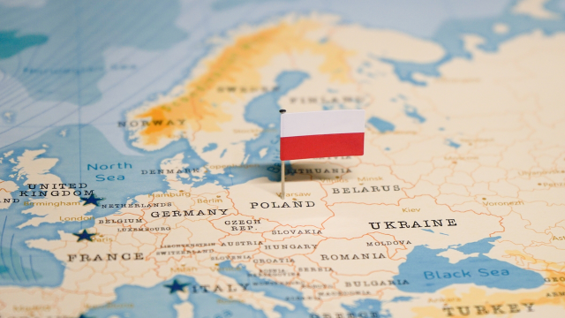

Slide 4
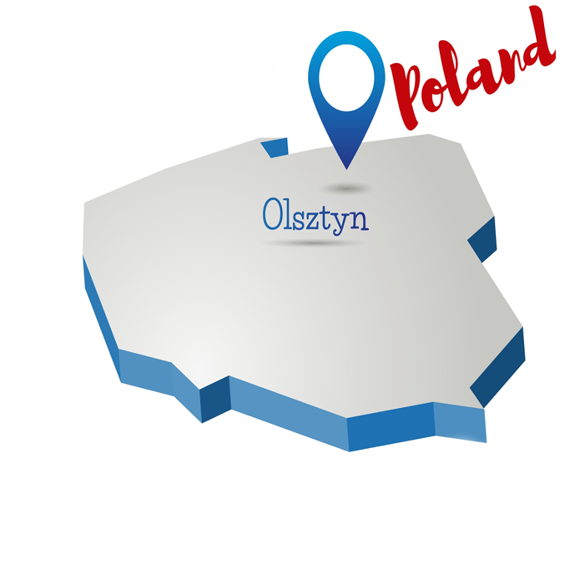
Location
University of Warmia and Mazury in Olsztyn (UWM) is located in north-eastern Poland
Olsztyn is perceived as one of the most beautiful cities in Poland – a country in the centre of Europe

Slide 5
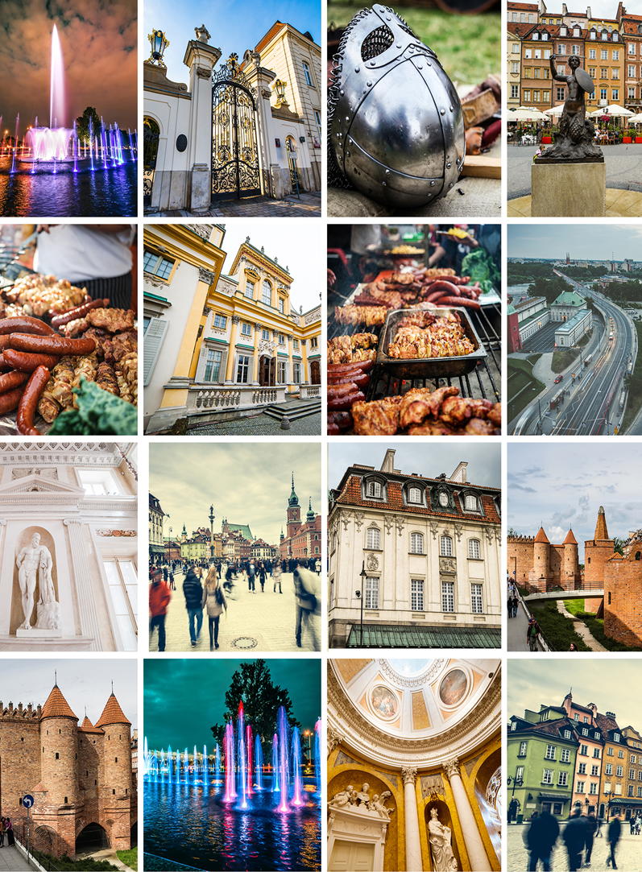
Visiting Poland
Poland is known for its rich history, stunning architecture, delicious food, and beautiful countryside
You can expect medieval castles, vibrant cities, picturesque towns, and beautiful landscapes including the Warmia and Mazury region with its breath-taking lakes and forests

Slide 6
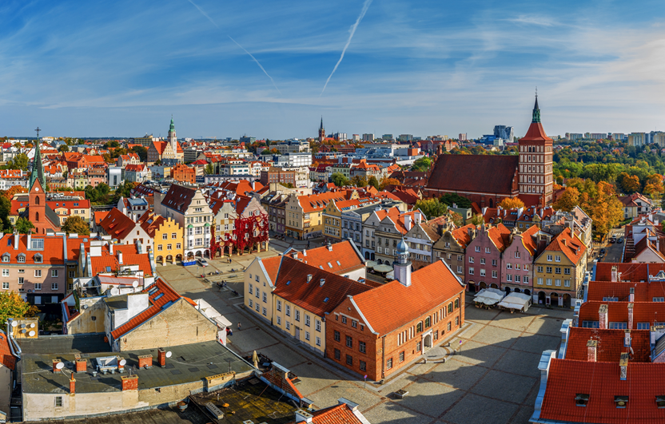
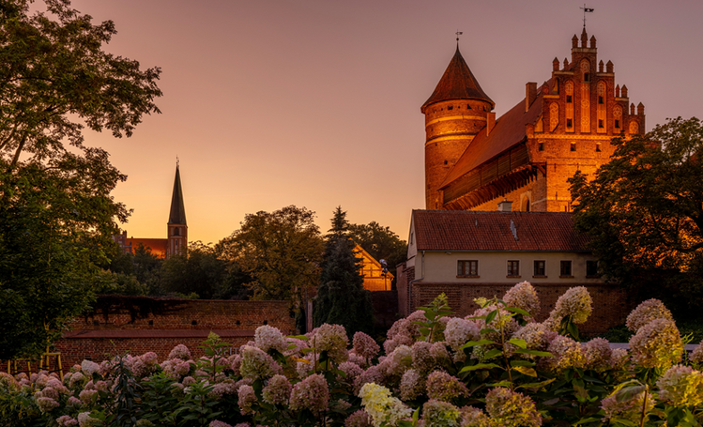
Best of Olsztyn
The capital of the Warmia and Mazury region inhabited by nearly 176,000 people
A renowned cultural and academic centre, boasting a large philharmonic, university, sports centre, in addition to numerous cinemas, theatres and cafes
The city's showcase is the medieval castle where Nicolaus Copernicus lived

Slide 7
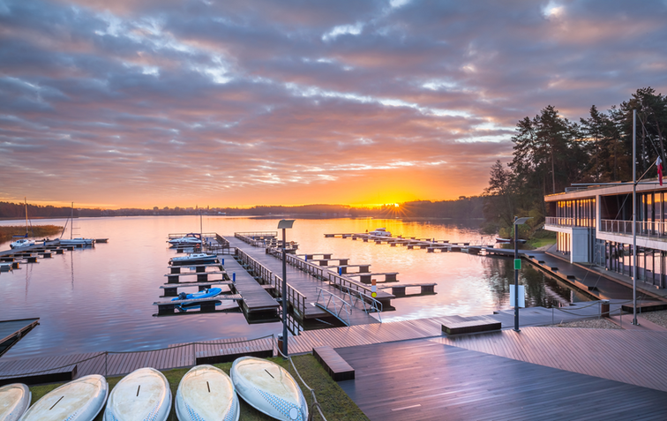
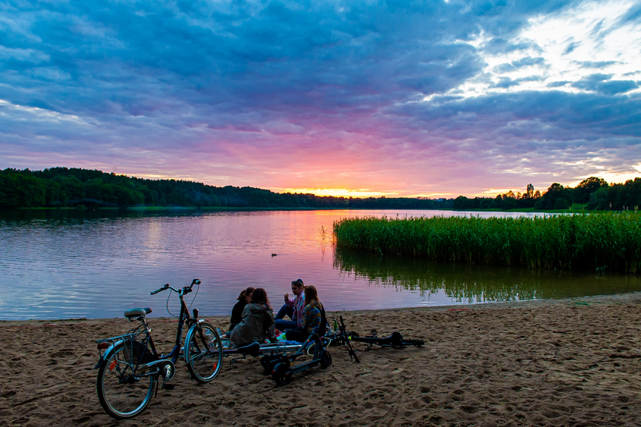
Best of Olsztyn
Olsztyn is surrounded by thick forests (they account for 20% of the city suburban area). There are also three rivers and 13 large lakes
Such surroundings make the city a popular holiday resort, with people flocking here to relax in its calm ambiance

Slide 8
University of Warmia and Mazury in Olsztyn
https://uwm.edu.pl/en

Slide 9
Some facts about UWM
Founded in 1999 through a merger of three higher education institutions: Academy of Agriculture and Technology, Pedagogical Institute and Warmia Institute of Theology
17 faculties:
  Animal Bioengineering; Biology and Biotechnology; Geoengineering; Humanities; Agriculture and Forestry; Medicine; Mathematics and Computer Sciences; Veterinary Medicine; Economic Sciences; Social Sciences; Technical Sciences; School of Public Health; Food Science; Law and Administration; Arts; Theology; Ełk Branch
More than 60 fields of study

Slide 10
Some facts about UWM
Approximately 16,000 students (2022/2023)
More than 150,000 graduates between 1999 and 2022
More than 1,700 academic teachers
Other units include:
Doctoral School, University Teaching Hospital, Collegium Medicum, Academic Cultural Center, Business Academy, Office for People with Disabilities

Slide 11
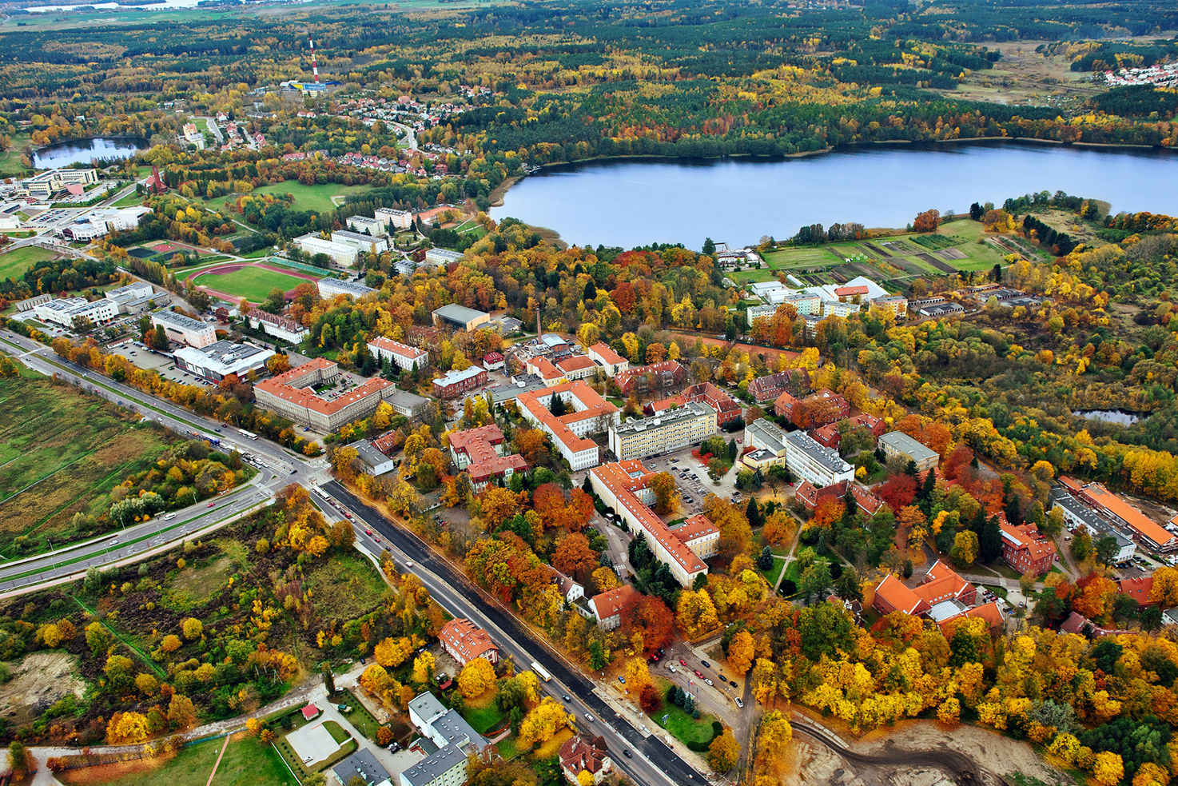
One of the most beautiful and unique university campuses in Poland
Located next to a lake and forests
The University adopted the Green University approach which assumes coexistence in harmony with the surrounding nature
Kortowo
– our campus

Slide 12
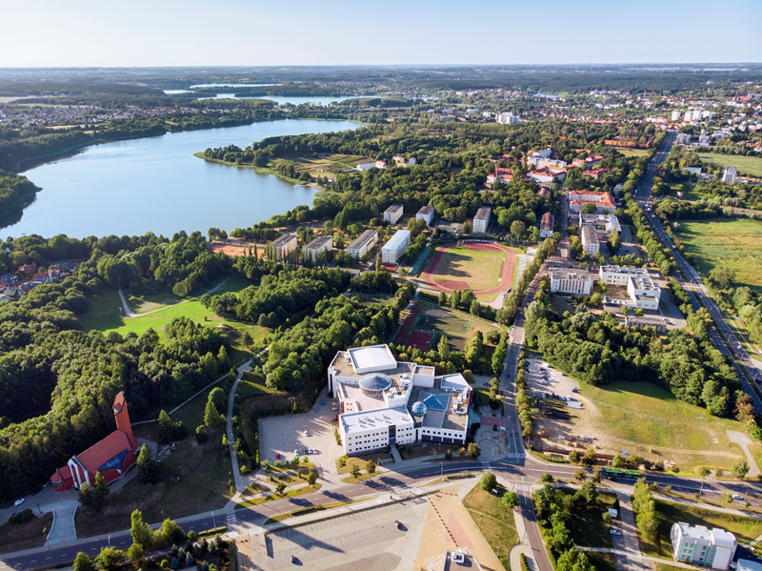
There are dormitories, student clubs, cafes, shops – everything students need to live, study and have fun
The Students' Parliament of the Republic of Poland awarded UWM the title of "Student-Friendly University" twice
Kortowo
– our campus

Slide 13
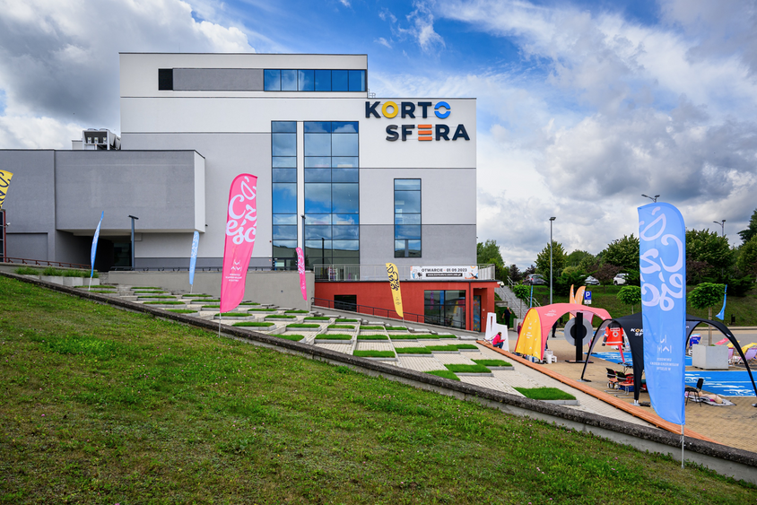
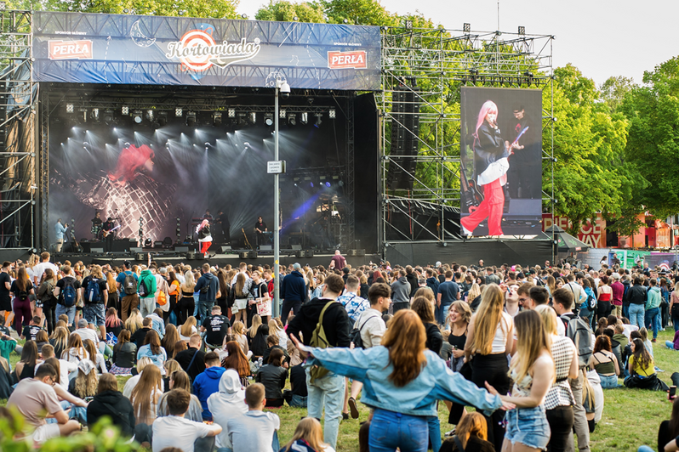
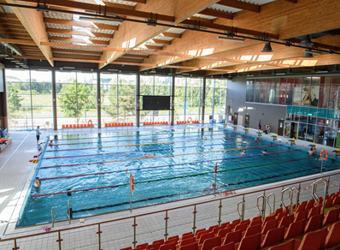
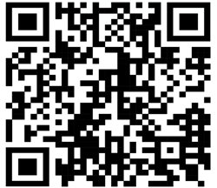
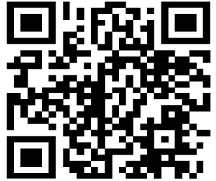
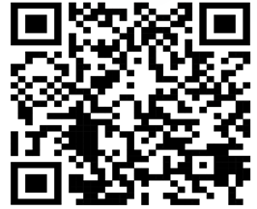
Campus activities
Centre for the Popularisation of Science and Innovation – Kortosfera
Students’ fest – Kortowiada
Swimming pool

Slide 14
Faculty of Economic Sciences
https://uwm.edu.pl/wne/

Slide 15
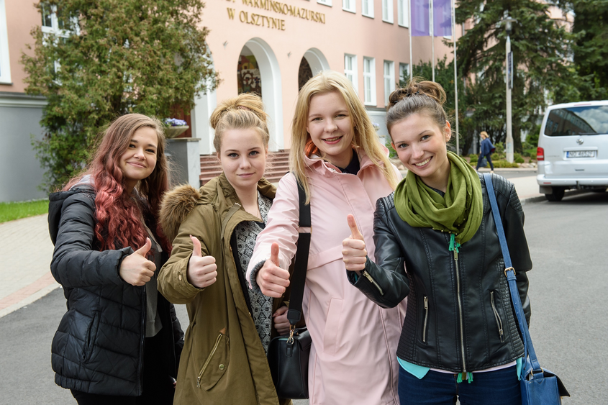
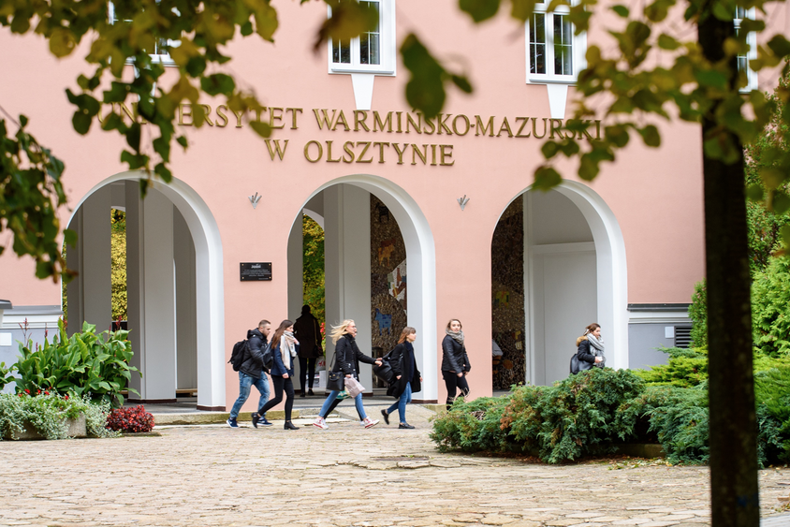
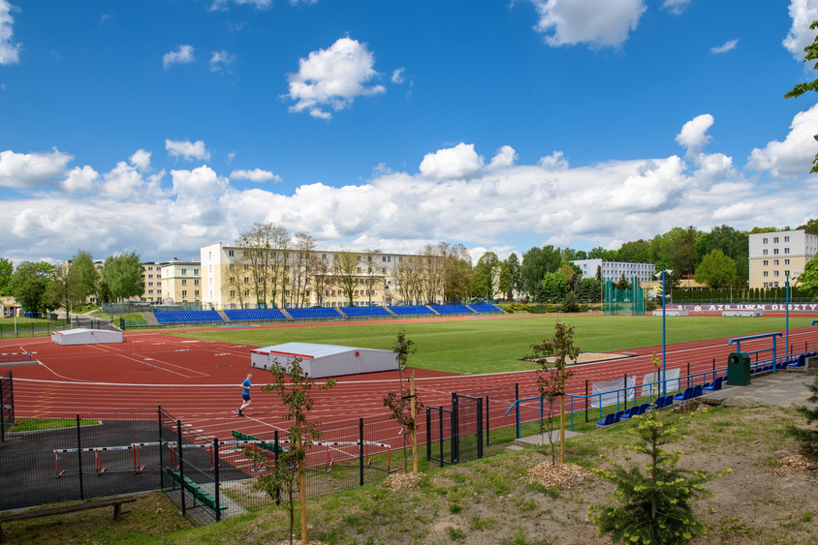
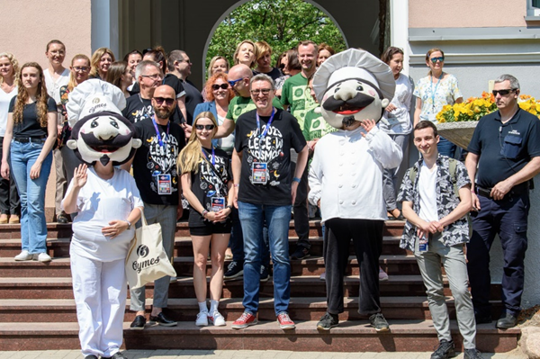
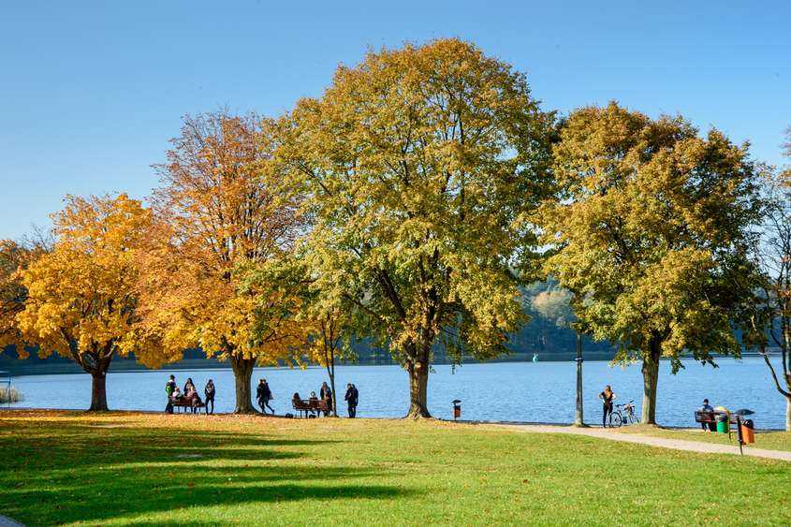
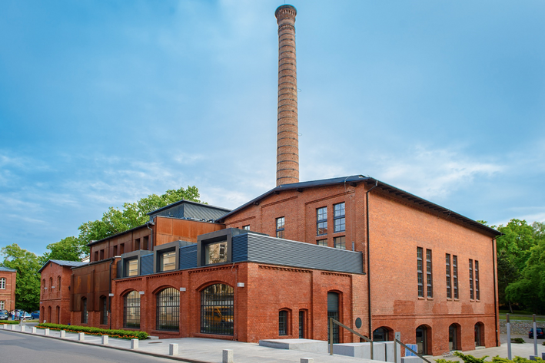
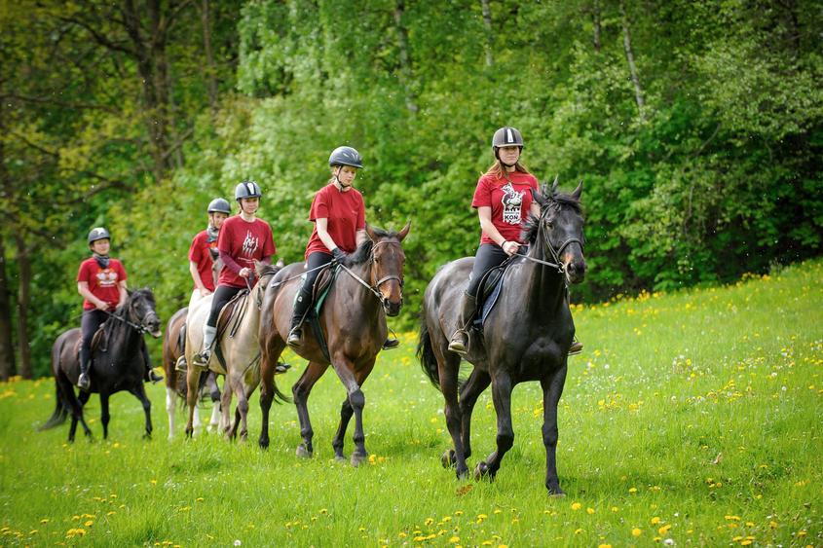
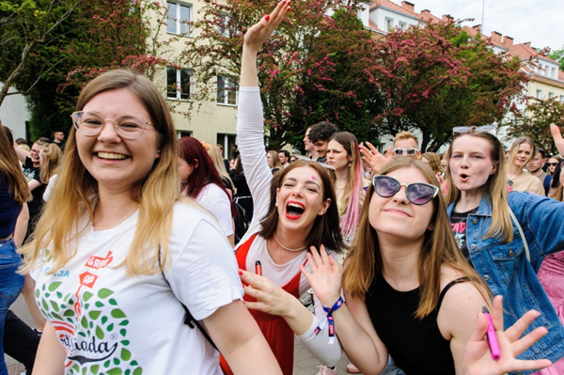
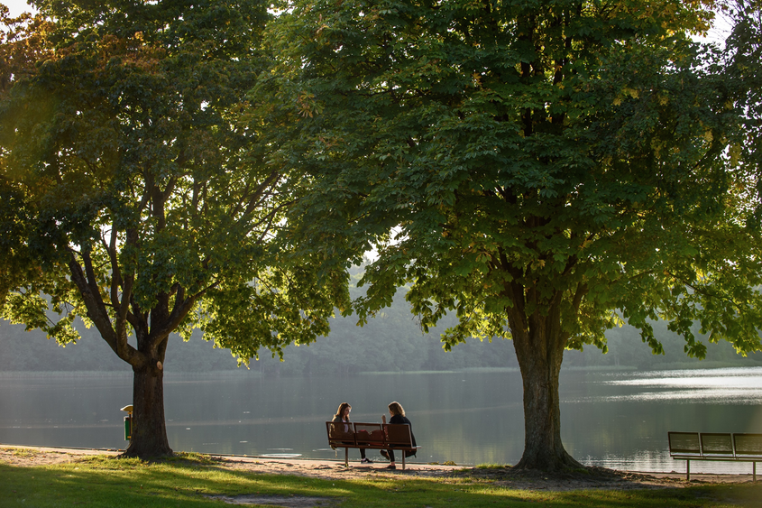
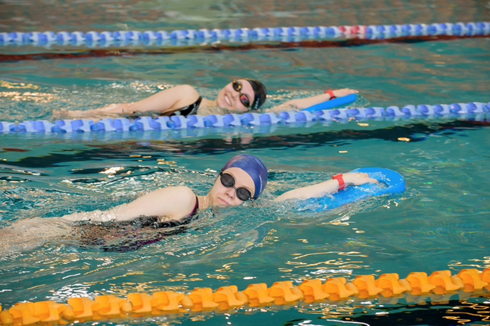
We create future leaders

Slide 16
Institutes and departments
Institute of Economics
and Finance
Department of Economic Policy
Department of Economy’s Competitiveness
Department of Finance
Department of Market and Consumption
Department of Theory of Economics
Institute of Management
and Quality Sciences

Slide 17

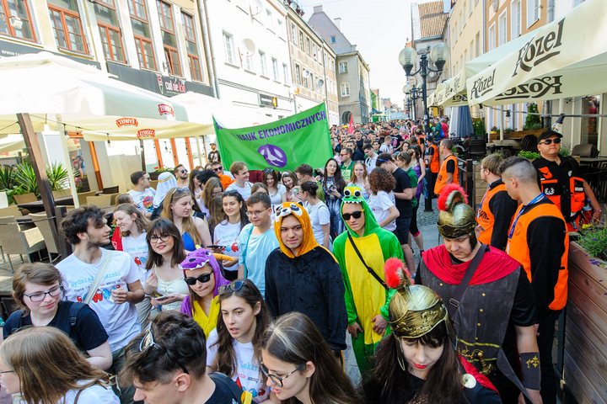
Faculty in numbers
Academic year 2023/2024
Academic year 2022/2023
Nearly 550 graduates including
the first graduates of a Master's degree
in Logistics with a double diploma under
an agreement with Instituto Politécnico de Setúbal (Portugal)
Around 2,100 students
More than 120 academic teachers and administrative staff

Slide 18

Our offer
Undergraduate degree programs:
Bachelor in Economics
Bachelor in Logistics
Bachelor in Management
Engineer in Management and Production Engineering

Slide 19
Our offer
Master’s degree programs:
Master in Economics:
(1) Managerial Economics and Business Consulting;
(2) Finance, Banking and Insurance;
(3) E-commerce and Services
Master in Management:
(1) Logistics;
(2) Marketing and Product Management;
(3) Accounting and Financial Management;
(4) Investment and Property Management

Slide 20
Our offer
Other postgraduate programs:
Master of Business Administration (MBA)
Accounting
Audit and Internal Control
Economics – Budgetary Accounting
Human Resources Management
Management and Marketing in Education
Managerial Coaching
The Faculty participates in
the Doctoral School of
University of Warmia and Mazury in Olsztyn

Slide 21
Erasmus+ courses*
Foreign investment | Economic history | History of economic thought | IT in management | Managerial decisions | Production logistics | Storage and transport
Financial markets | Entrepreneurship | Innovativeness of enterprises | Operational research | Methods of organization and management | Public finance | Strategic management
Corporate finance | European economic integration | Investment project evaluation methods | Macroeconomics | Microeconomics of competitiveness | Social policy | *for information on currently running courses please contact erasmus.wne @uwm.edu.pl
Corporate social responsibility | Finance | International enterprise | Management accounting | Negotiations | Risk analysis
Economic Policy | Logistics | International marketing | Mathematical statistics | Process management | Sales techniques
Econometrics | Logistics consumer service | IT in logistics | Management concepts | Transport economics | Statistics

Slide 22

ERASMUS+
We cooperate with many universities
and would like to extend our cooperation
Contact:
Kamil Kotliński, PhD
Anna Wichowska, PhD
Erasmus+ coordinator
(incoming and outgoing students/faculty/staff,
bilateral agreements)
e-mail: erasmus.wne@uwm.edu.pl
Erasmus+ coordinator
(training, promotion)
e-mail: anna.wichowska@uwm.edu.pl

Slide 23









Student scientific societies
Scientific Society
of Human Resource Management "Creative"
Coaching Scientific Society
"Real Estate"
Students’ Scientific Society ”Business Club"
Scientific Society
of Economic Liberalism
Scientific Society
of Accounting
Coaching Scientific Society
"The Best Passion"
Scientific Society
of International Economics
Scientific Society
of Logistic "Logistix"
Investors Scientific Society

Slide 24
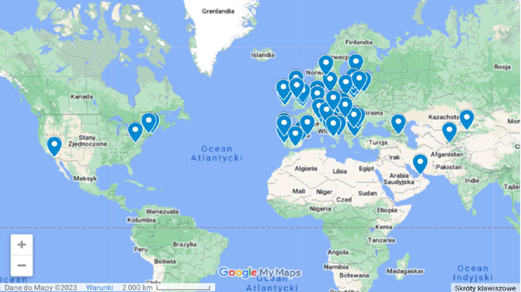
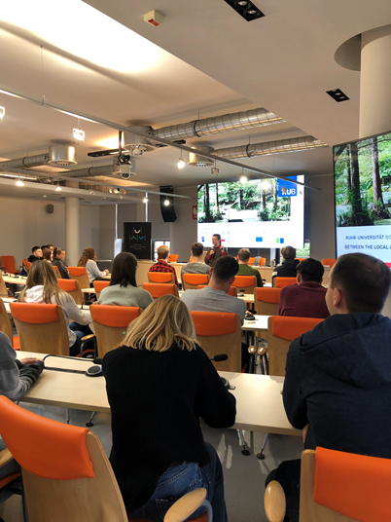
International cooperation
Open Lectures in English
Lectures conducted by invited lecturers from abroad
Staff mobility
The staff of the Faculty of Economic Sciences
actively participates in numerous conferences, seminars, panels and other scientific events organized in Poland and abroad as well as research internships in foreign research centers

Slide 25
We would like to express our interest in establishing new partnerships with universities and research institutes as well as individual researchers
Do not hesitate to contact us if you or your organization are willing to discuss any forms of collaboration

Slide 26
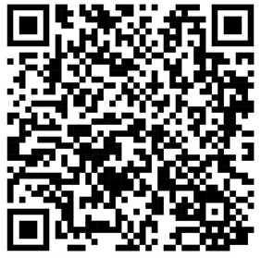
Thank you!
Faculty of Economic Sciences
Oczapowskiego St. 4
10-719 Olsztyn
Poland

